Slide 1
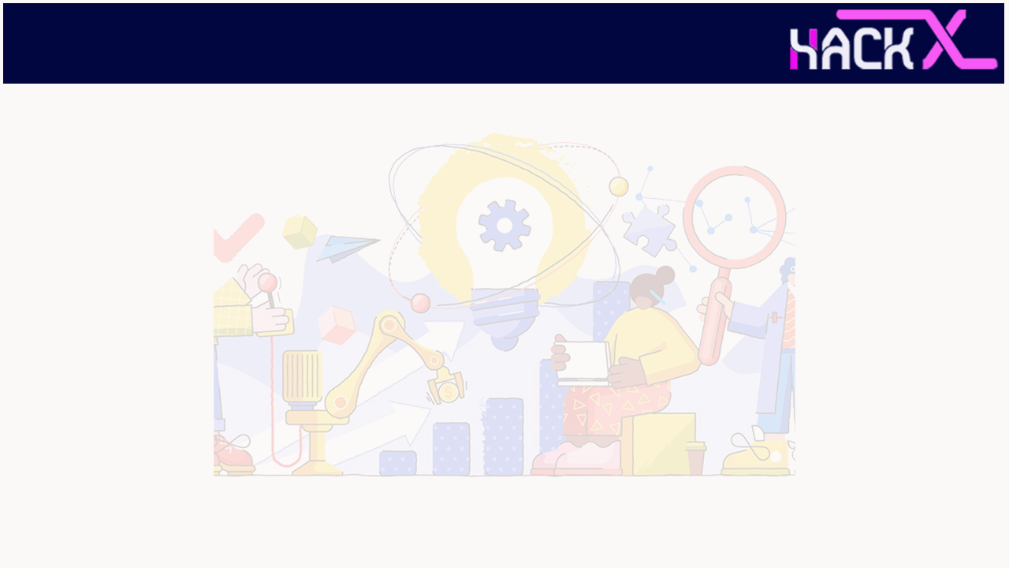
SLIDE 1
AGNO
2. Ayan Ghosh(Leader)
3. IoT
4. A simulation or hardware for monitoring the plant condition in agriculture by the farmer for daily monitoring the growth of the crop.

Slide 2
SLIDE 2
ABSTRACT
IoT-driven smart greenhouses can intelligently monitor as well as control the climate, eliminating the need for manual intervention. Various sensors are deployed to measure the environmental parameters according to the specific requirements of the crop.

Slide 3
SLIDE 3
NOVELTY
Given the system with 2 modes
1. MANUAL MODE(DEFAULT)- Here we have to manually control each and every appliances of the greenhouse using the phone app. Here no such decision will be taken by the system. 2. AUTONOMOUS MODE- Here the system will take action by its own like turning on the heater,leds,pumps when ever it is needed and in this mode it not obey any command inputted from the app.

Slide 4
SLIDE 4
TECHNOLOGY
STACK
We had used IoT with AI and ML for controlling and monitoring the plant data and also to check if there is any disease in the plant and how to cure them.

Slide 5
SLIDE 5
HARDWARE / SOFTWARE IMPLEMENTATION
I had used DHT11 and moisture sensor for capturing the plant data and there is also a water pump, cooling fan and retractable roof for making optimum condition for the plant to grow more healthy.
All the parameters and controlling can be integrated in an APP, I will be making the app in MIT APP INVENTORY.

Slide 6
SLIDE 6
1
Huge demand=Huge commission
Fresh off season vegetables
2
Electricity Cost
Repairing cost
3
Huge profit
Revenue recovered in <5years
Labour cost(min)
BUSINESS SCOPE

